Slide 1
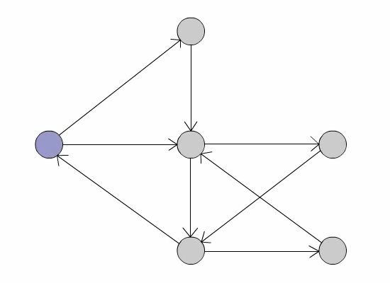
An Investigation of Hebbian Phase Sequences as Assembly Graphs
2015.4.7
William Duo Erika

Slide 2
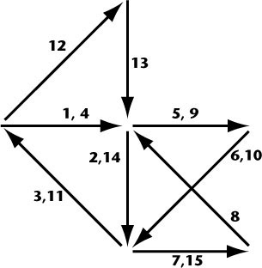
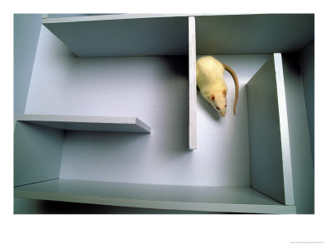
Cell Assemblies: Basic Unit of Neural Grammar
Plasticity
Hebb, Donald Olding. The organization of behavior: A neuropsychological theory. Psychology Press, 2005.

Slide 3
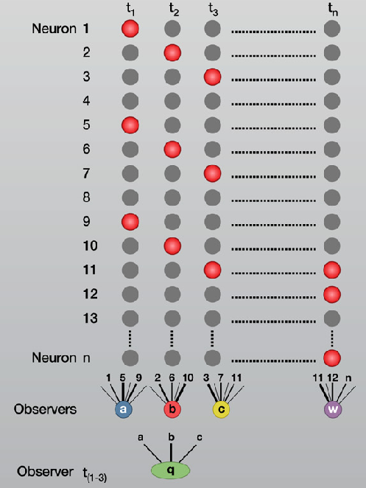
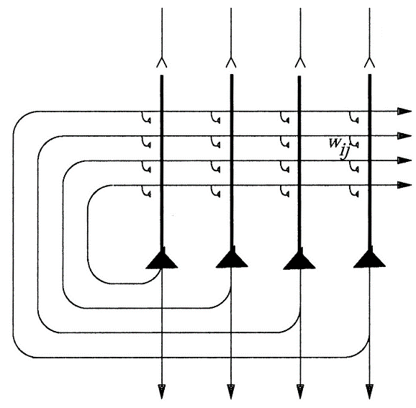
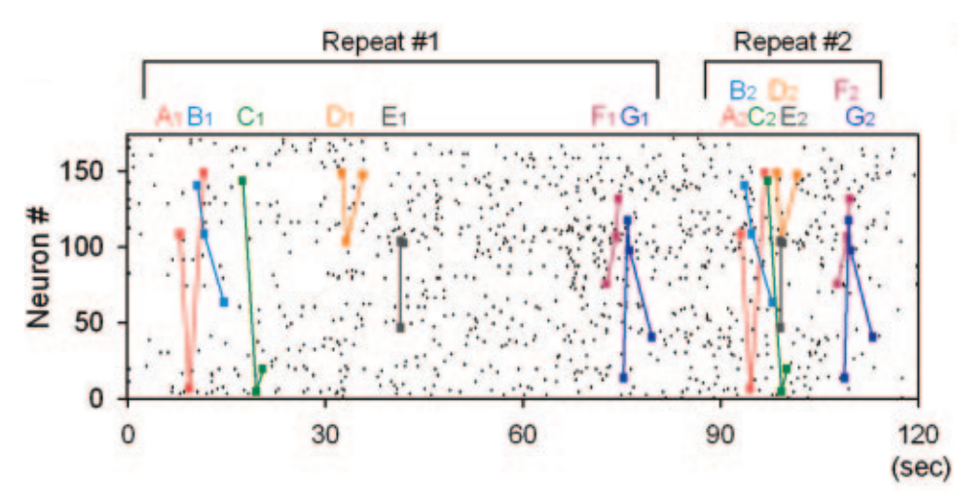
How might this work?
Reader Neurons
Attractor Networks
Synfire Chains
…not mutually exclusive, just representative of the type of ideas out there regarding assemblies
Buzsáki, György. "Neural syntax: cell assemblies, synapsembles, and readers."Neuron 68.3 (2010): 362-385.
Ikegaya, Yuji, et al. "Synfire chains and cortical songs: temporal modules of cortical activity." Science 304.5670 (2004): 559-564.

Slide 4
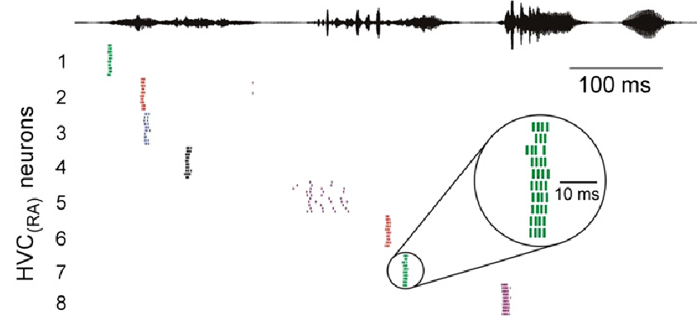
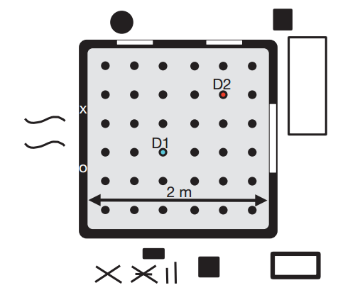
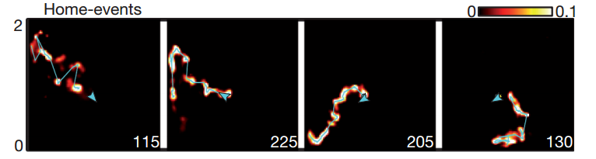
Evidence that this is a thing
A.
B.
Hahnloser, R.H., Kozhevnikov, A.A., and Fee, M.S. (2002). An ultra-sparse code underlies the generation of neural sequences in a songbird. Nature 419, 65–70.
Pfeiffer, Brad E., and David J. Foster. "Hippocampal place-cell sequences depict future paths to remembered goals." Nature 497.7447 (2013): 74-79.

Slide 5
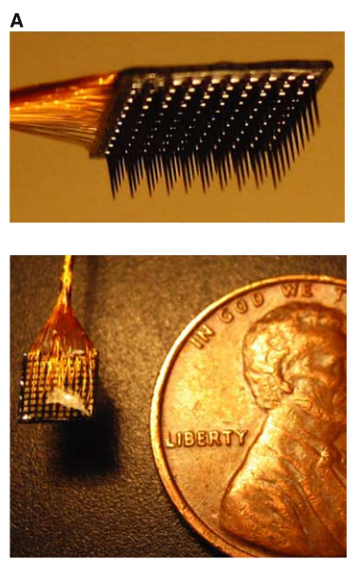
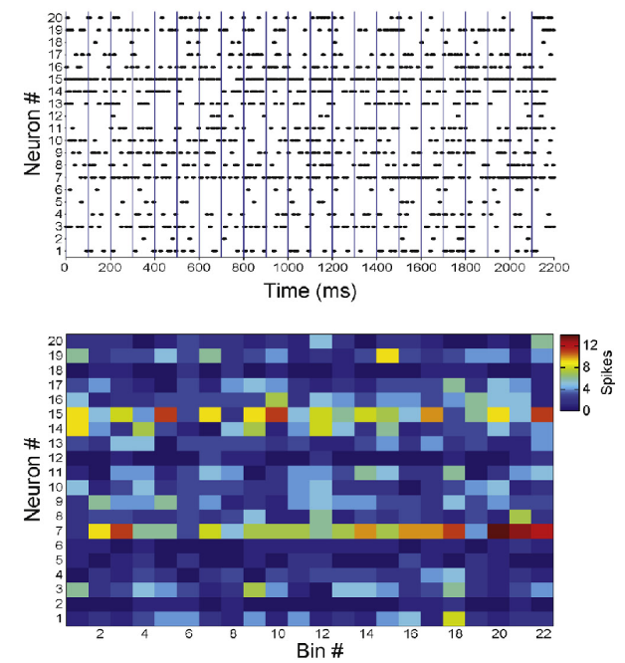
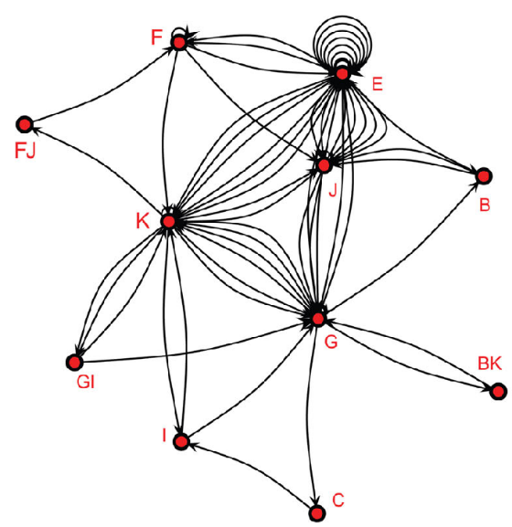
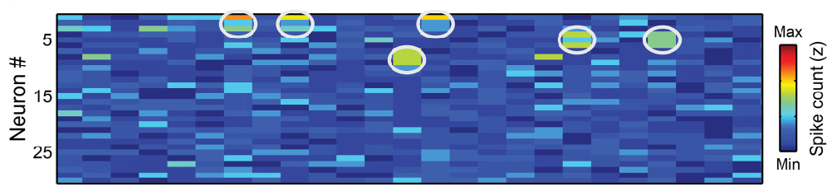
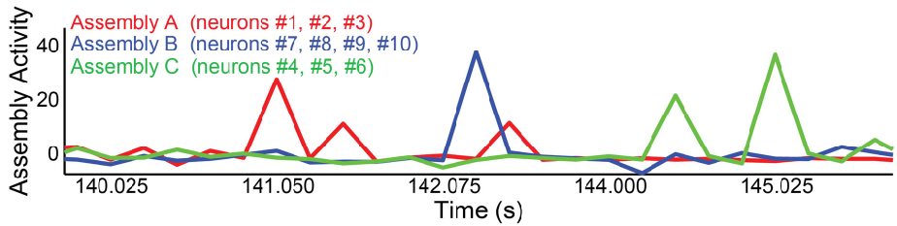
Challenges
A.
B.
C.
time
Kelly, Ryan C., et al. "Comparison of recordings from microelectrode arrays and single electrodes in the visual cortex." The Journal of neuroscience 27.2 (2007): 261-264.
Lopes-dos-Santos, Vítor, et al. "Neuronal assembly detection and cell membership specification by principal component analysis." PLoS One 6.6 (2011): e20996.

Slide 6
From Spikes to Graphs
Actions
From Spikes to Assembly Activations
From Assembly Activations to Graphs

Slide 7
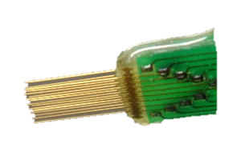
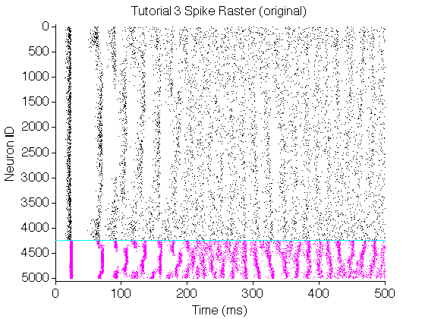

From Spikes to Assembly Activations
Electrode array

Slide 8
From Spikes to Assembly Activations
Binning
Optimization
Normalization
Z-score

Slide 9
From Spikes to Assembly Activations
PCA
ICA

Slide 10
From Spikes to Assembly Activations
PCA
ICA

Slide 11
From Spikes to Assembly Activations
Thresholding at 99%
Thresholding at 99%
Thresholding at 99%

Slide 13
From assemblies to graphs
Nodes are cell assemblies
Edges are temporal sequence of consecutive node activations
If two assemblies are activated simultaneously, create a unique node
Notes:
Directed and allows self loops

Slide 14
Graph Attributes
Properties of a graph that depend only on the abstract structure of the graph and not on any particular labeling of the graph
Common graph attributes | Other attributes
Number of nodes Number of repeated edges Number of parallel edges Largest strongly connected component Average total degree Density of the graph Diameter of the graph Average shortest path Clustering coefficient | Number of self loops Number of loops with two nodes Number of loops with three nodes Largest connected component
Notes:
Define and translate into neuroscience
LSC: largest subgraph
ATD: mean number of edges pointing to or departing from a node, across nodes
Density: percent of possible edges that really exist
Diameter: length of shortest path between node pairs
Clustering coefficient: degree to which nodes in a graph tend to cluster together. average across nodes of the percentage of real edges between the neighbor nodes of a node over the total possible edges between these neighbors

Slide 15
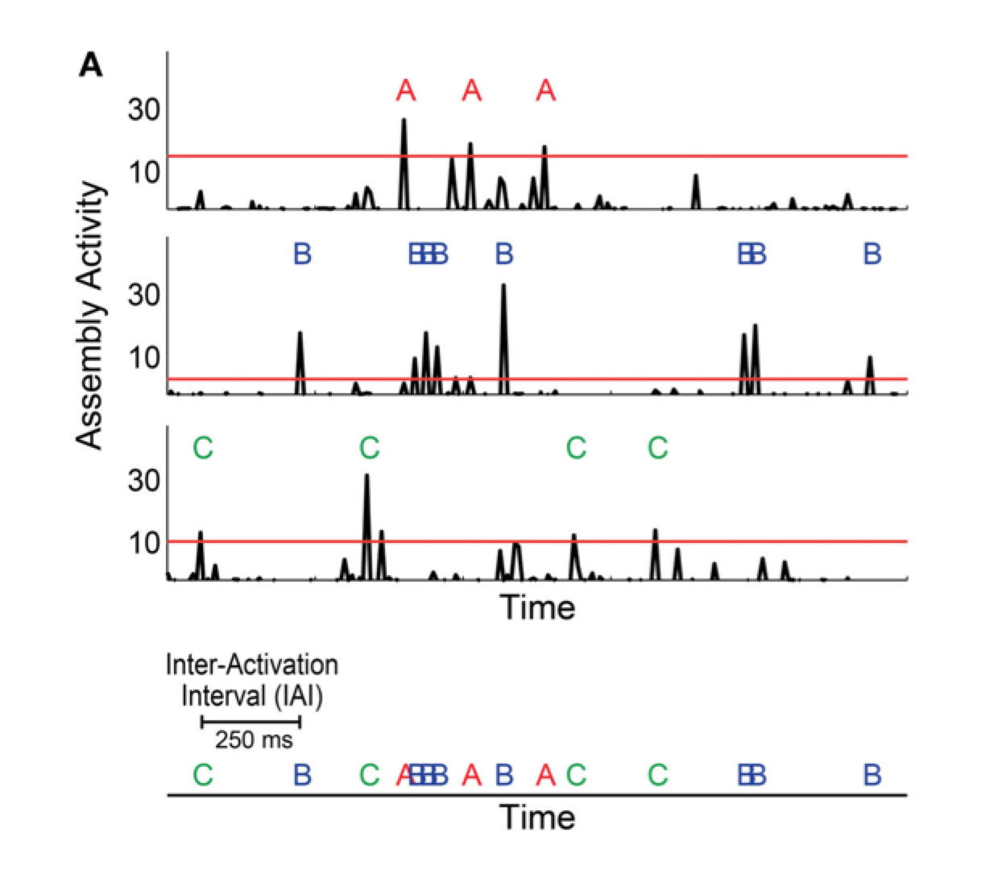
Parameters that shape the graph
Notes:
The graphs are shaped by maximum IAI and number of activations per graph (i.e. activation count)
Idea: what defines a consecutive activation? How should we limit an epoch?

Slide 16
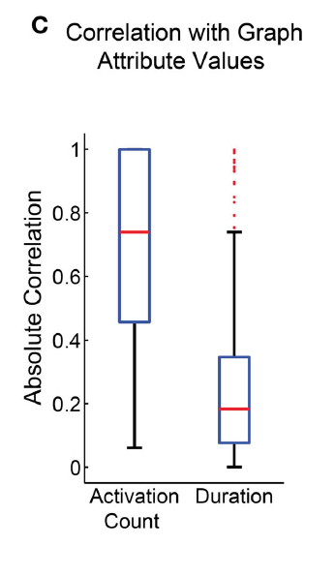
Graph parameters and attributes
Notes:
Fixed number of assembly activations per graph to control for the variability in the graph attributes (across periods that they evaluated)

Slide 17
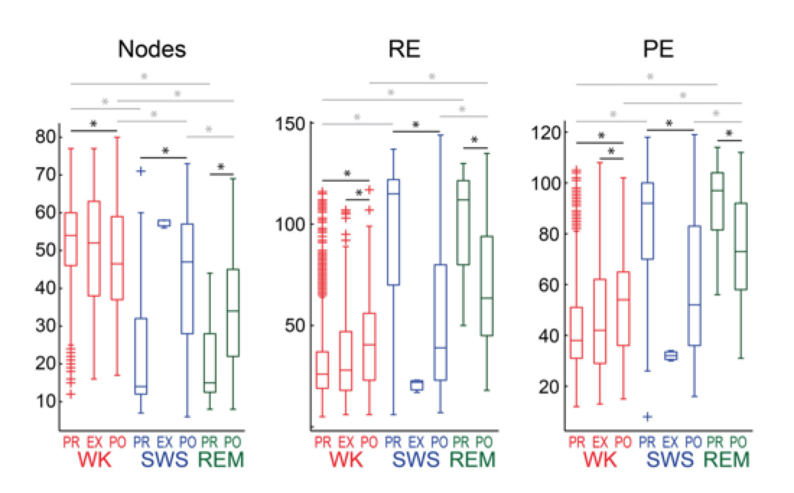
Results: descriptive statistics

Slide 18
Results: descriptive statistics
13 attributes were significantly different between WK and SWS
12 attributes were significantly different between WK and REM in PRE and 11 in POST
10 attributes were significantly different between SWS and REM in POST, but none in PRE
PRE and POST within SWS and REM were significantly different across all attributes, across 12 attributes for WK

Slide 19
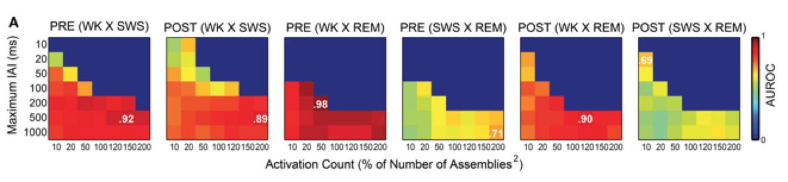
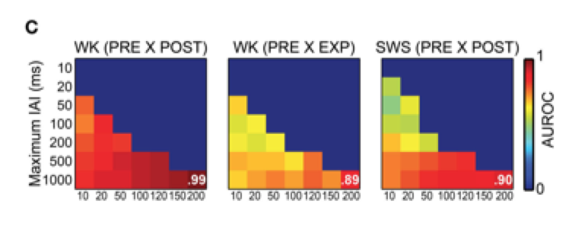
Results: Naïve classifier
Notes:
A: Color bar: 0-1 represent the median AUROC of 50 classifications made for 20 random graphs from each of the periods for comparison. Dark blue: impossible to classify, could not obtain the minimum 20 graphs necessary.

Slide 20
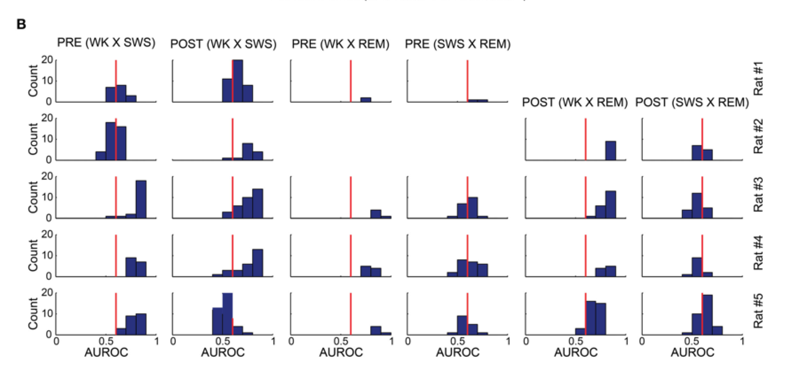
Results: Naïve classifier
Notes:
Histograms of the median AUROC values for 50 classifications made for 20 random graphs from each of the experimental periods using a Naïve Bayes classifier for all rats. I.e. values from first figure. The red line depicts the 0.6 AUROC value, which sets the lower bound for good classification quality. WK and REM were well sorted, especially during PRE.

Slide 21
Results: Naïve classifier
Notes:
Histograms of the median AUROC values for 50 classifications made for 20 random graphs from each of the experimental periods using a Naïve Bayes classifier for all rats. I.e. values from first figure. The red line depicts the 0.6 AUROC value, which sets the lower bound for good classification quality. WK and REM were well sorted, especially during PRE.

Slide 22
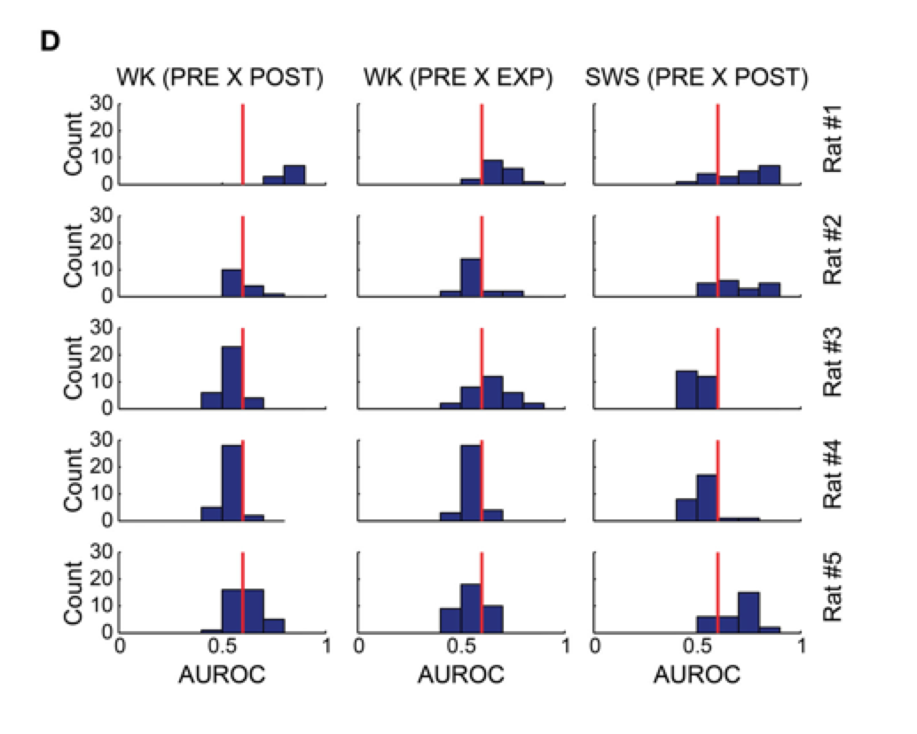
Results: Naïve classifier
Notes:
Does not perform as well in classifying experimental period within behavioral state

Slide 23
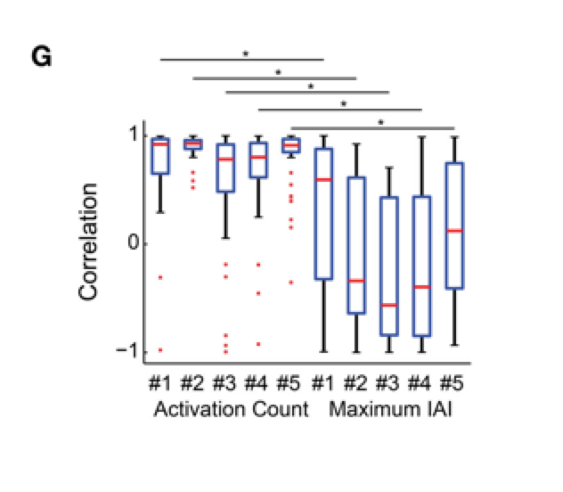
Results: Naïve classifier
Notes:
Strong correlation between AUROC and activation count

Slide 24
Summary of results
Graph attributes vary significantly across behavioral states and experimental periods
Naïve Bayes classifier can sort behavioral states quite well, which validates the model

Slide 25
Future Directions
Increase number of recorded neurons through advancements in MEA tech
Apply more sophisticated graph theoretic techniques to data, for example…?
Parse out behavioral correlates of individual assembly sequences, i.e. further explore neural syntax
Analyze more in continuous time domain (i.e. break up IAI).

Slide 26
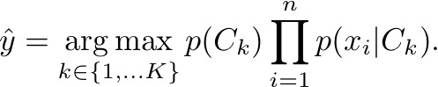
Supplementary: Bayes Classifier
X is an instance with n features
Ck is the classification for k possible outcomes
Assumes the value of any particular feature is independent of the value of any other feature, given the class variable

Slide 27
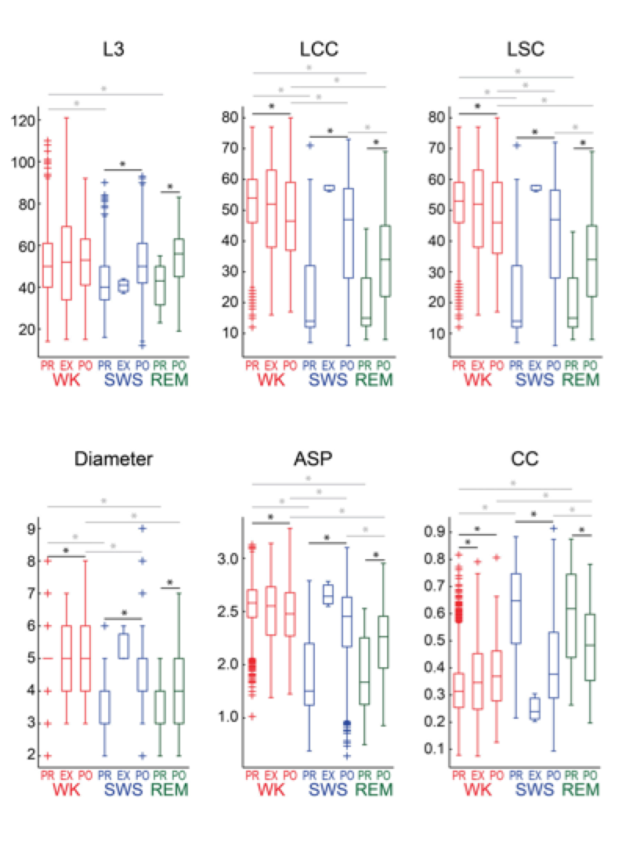
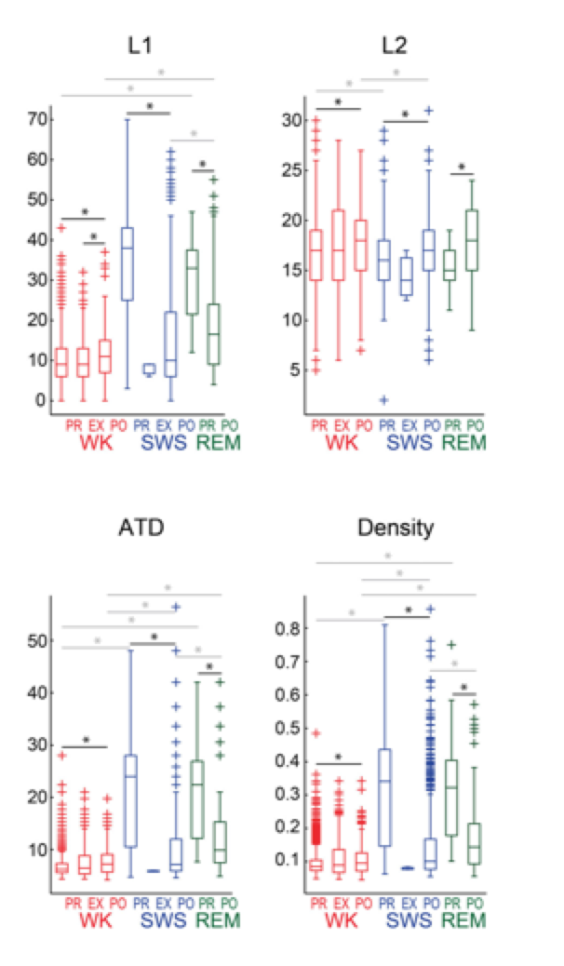
Supplementary Slide
Notes:
All attributes sorted WK from SWS during PRE or POST except L1 during PRE and L3 during POST
WK was significantly different during REM during PRE (12 attributes) and POST (11 attributes).
SWS was significantly different from REM during POST (10 attributes) but no attribute could sort SWS and REM during PRE
Only one attribute was capable of sorting PRE from EXP within WK, but 12 attributes could separate PRE and POST within WKE. PRE SWS could be sorted from POST SWS and PRE REM could be sorted from POST REM using any of the attributes studied

